Slide 1
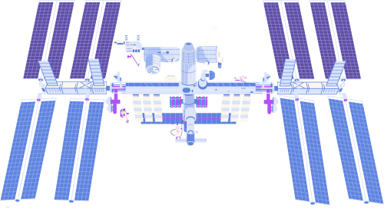


Final Project
Customer Churn Analysis

Slide 2


Problem Statement
Why existing Customers leaving the bank ?

Slide 3

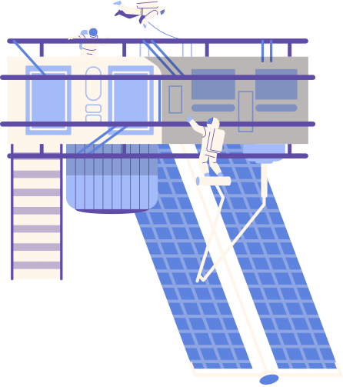
We here use Bank DataSet which is consist of many files
Dataset
Active Customer
Bank Churn
Credit Card
Customer Info
Exit Customer
Gender
Geography

Slide 4

Data Cleaning and Preparation
1
Duplicates
2
Missing values
Check for duplicates
and remove it
Check for missing values
and remove it
Data
3
We make it suitable
For visualization

Slide 5

Modeling
Primary Sources
We Make The relations between tables to connect it to each other By linking each row to its appropriate description in the other table and giving it the appropriate relationship.

Slide 6
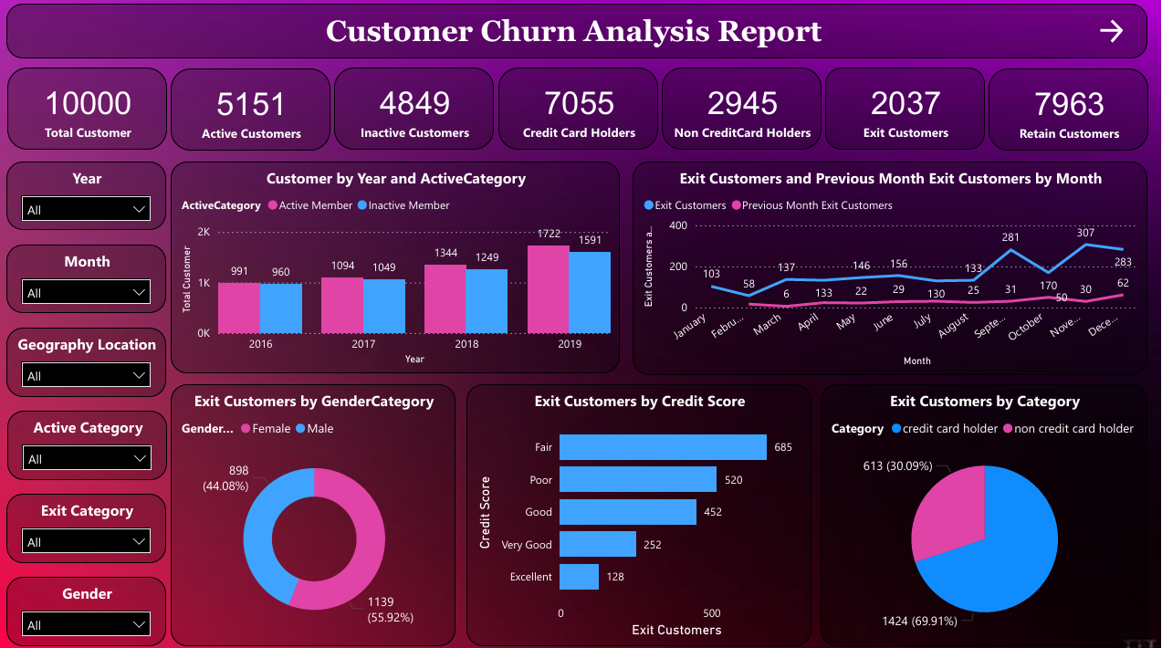

Slide 7
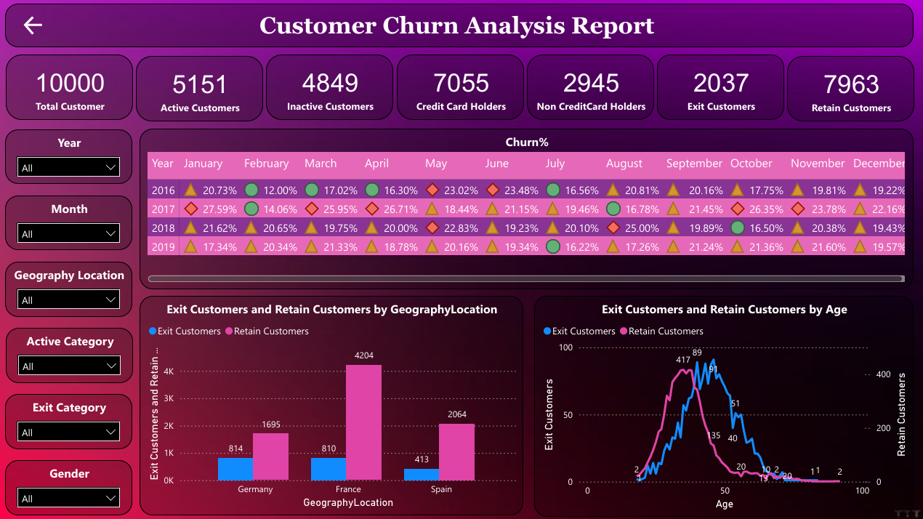

Slide 8

1
Target High-Risk Groups with Personalized Campaigns
2
Region-Specific Solutions
3
Support Low Credit Score Customers
Recommendations
4
Strengthen Customer Loyalty Programs
5
Engage Credit Card Holders with Tailored Benefits
6
Proactive Churn Prevention
7
Enhance Customer Service Experience

Slide 9
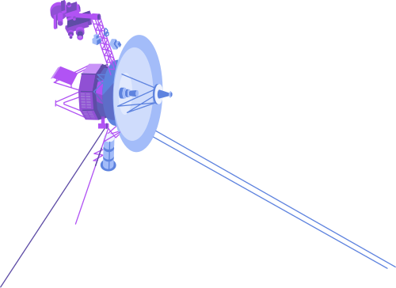
ThAnks
Do you have any questions?
Mahmoud Shogaa
Hassan Medhat
Abdelrahman Saleh

